Slide 1
Senedd – 13th January 2020
OUR VOICE MATTERS

Slide 2

Article 12: The right to have our opinions and voices heard.

Slide 3


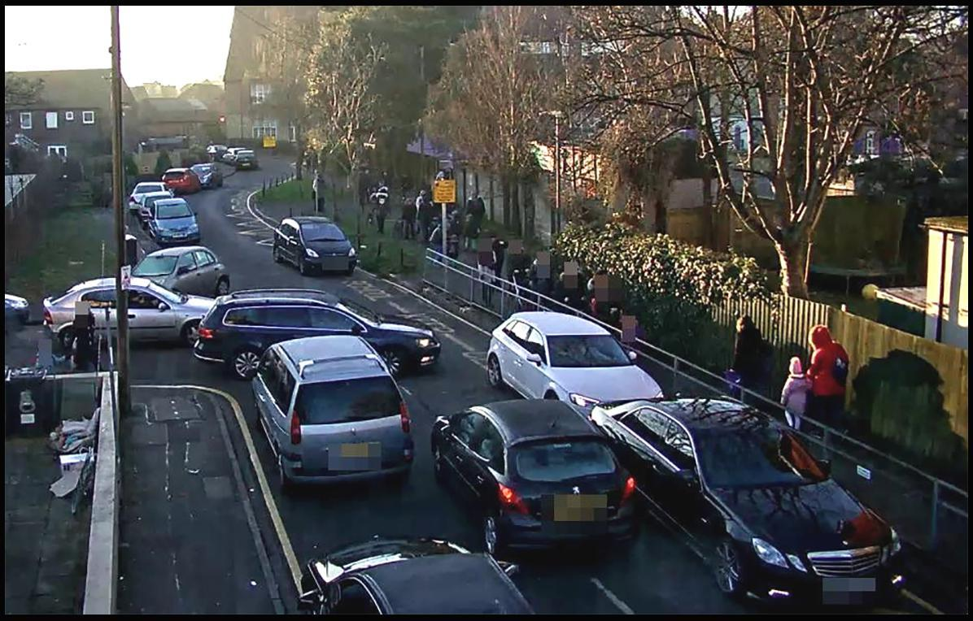
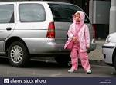
How does this make you feel?

Slide 4
Insert video here

Slide 5
Time to have our say!
How would you like to come to school everyday?
What would make you feel safe when walking/cycling to school?
How can we make more families walk/cycle/scoot to school?
Competitions?
How will families other children know about it?

